Slide 1



Slide 2

E-Learning for partial Deaf and Dumb kids
Group Members:
Hamza Tufail(FA16-BCS-012)
Muhammad Rizwan(FA16-BCS-034)
Supervised by:
Tahira Sadaf
Department of Computer Science
COMSATS University Islamabad, Attock Campus

Slide 3
Outline
_______________________________
Introduction
Related Work / Applications
Problem statement
Objectives
Methodology
Modern tools
Project Implementation
Future Work
References
_______________________________

Slide 4
Introduction
_______________________________
Many kid out there facing difficulties in their communication as compared to normal kids due natural deficiencies like hearing issues and dumbness.
According to WHO 5% of every country’s population has some sort of hearing impairment and wordlessness.
Pakistan, has also a large scale of this kind od disabilities.
With various technological developments, with the help of proper training and mobile device applications now we can train the kids at home as well as in schools.
_______________________________

Slide 5
Related Work
_______________________________
Name | Weakness | Proposed System Solution
ABC Kids | Not much learning in the app kids just have to draw alphabets | Our system will provide a complete learning scenario With Test section and involvement of doctor is also included
Kids education | No testing modules present. Performance and UI is really weak | Our system will provide variety of modules for proper learning of kids .Performance and UI will be neat
Kid’s learning time | Just single module of learn | With different strategies we will create an environment to develop kid interest
_______________________________

Slide 6
Problem Statement
_______________________________
Pakistan don’t facilitate these kids much. Many kids with these kind of disabilities facing issues in their learning stages.
About 1365 institutions have been educating students with disabilities which is very low in number .
No such Applications were available that specifically targets the kids with disabilities like wordless and hearing issues
_______________________________

Slide 7
Objectives
_______________________________
Enhance the communication skills of Kids with
Hearing issues and wordlessness.
Create a connection between a doctor and a kid.
Provide a Mobile application most of the peoples could be facilitated.
Monitoring the learning of a kid and providing extra Videos and images as per requirement
_______________________________

Slide 8
Methodology
_______________________________
Monitor
Tests of different types were taken
In order to test the learning of the kids then report will be sent to the appointed doctor.
Appointment
Parent needs to get appointment
from the doctor first so they are linked to the doctors and could be able to send result to the doctor
Learning
Extra Content
Extra Content could be added in different categories as per requirement
to fulfill the requirement and
To add the content suggested by the doctor
User Interface
User interface is designed to facilitate the kids, doctors as well as parents to acquire the goal of better understanding
Different Modules like fruit , vegetables, voices and Animals were available having series of videos and images interlinked
_______________________________

Slide 9
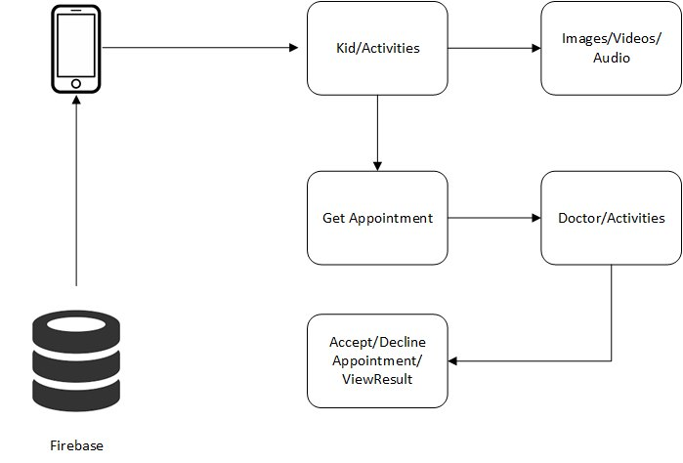
Architecture Diagram
_______________________________
_______________________________

Slide 10
Data Flow Diagram
_______________________________
DFD Level 0
_______________________________

Slide 11
Data Flow Diagram
_______________________________
_______________________________
DFD Level 1

Slide 12
Use Case Diagram
_______________________________
_______________________________

Slide 13
Activity Diagram
_______________________________
_______________________________

Slide 14
Sequence Diagram
_______________________________
_______________________________

Slide 15
Modern Tools
_______________________________
Modern Tools
Tools | Version | Rationale
Android Studio | 2019 | IDE
Photoshop/Illustrator | CC | Design
MS Word | 2010 | Documentation
PowerPoint | 2016 | Presentation
Visio | 2016 | ER Diagrams
Java | 8.0 | Programing Language
_______________________________

Slide 16

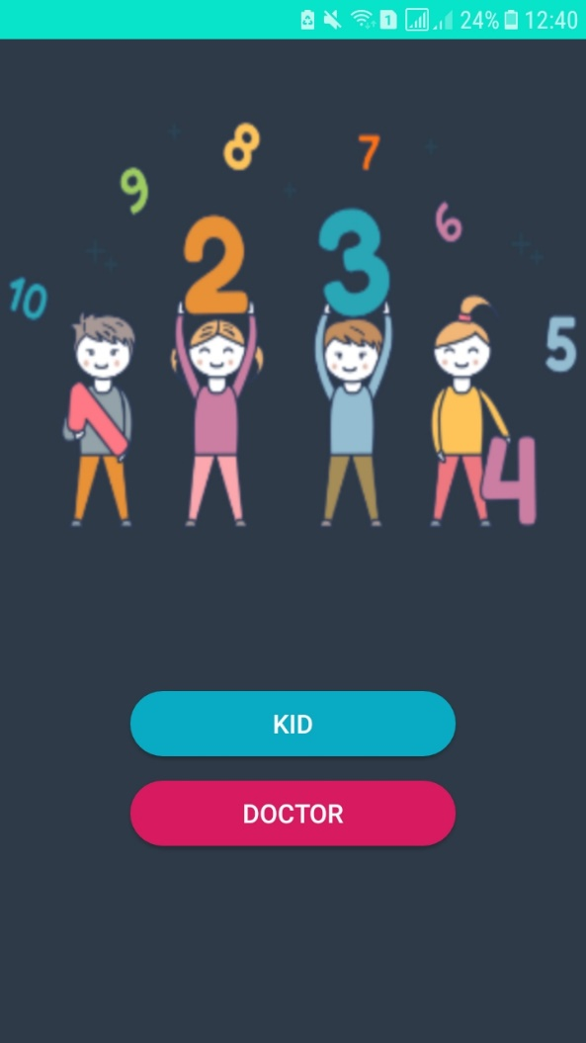
User Interface
_______________________________
_______________________________

Slide 17
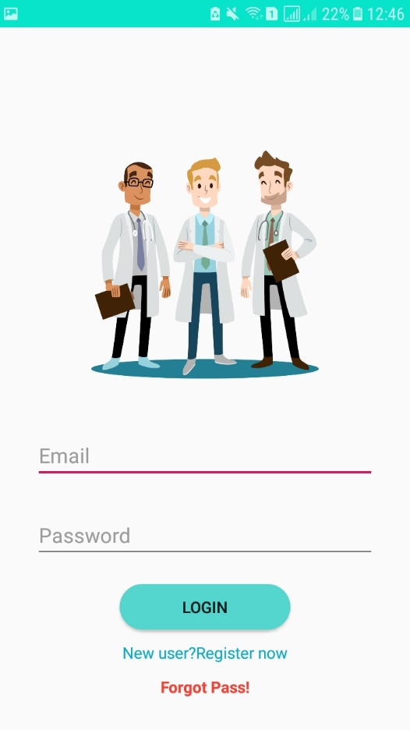
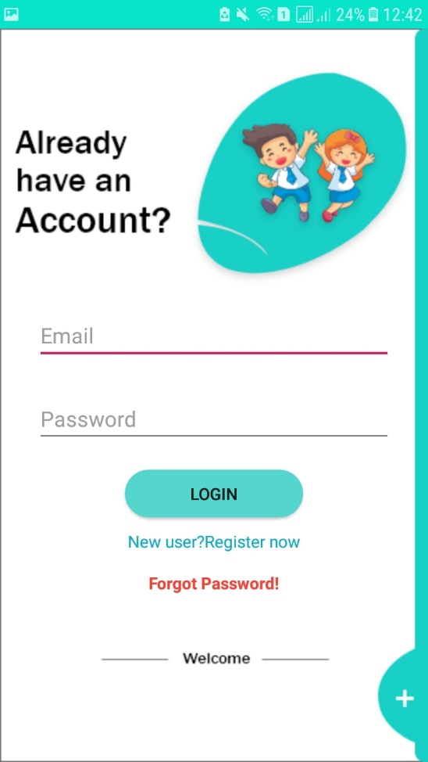
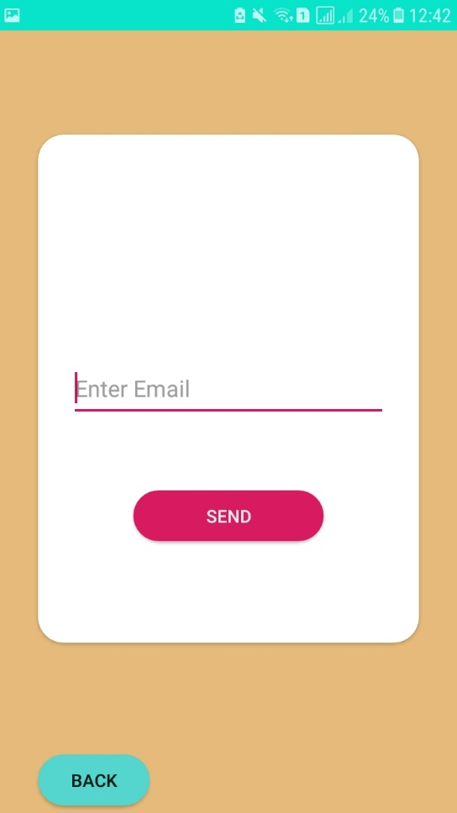
User Interface
_______________________________
_______________________________

Slide 18
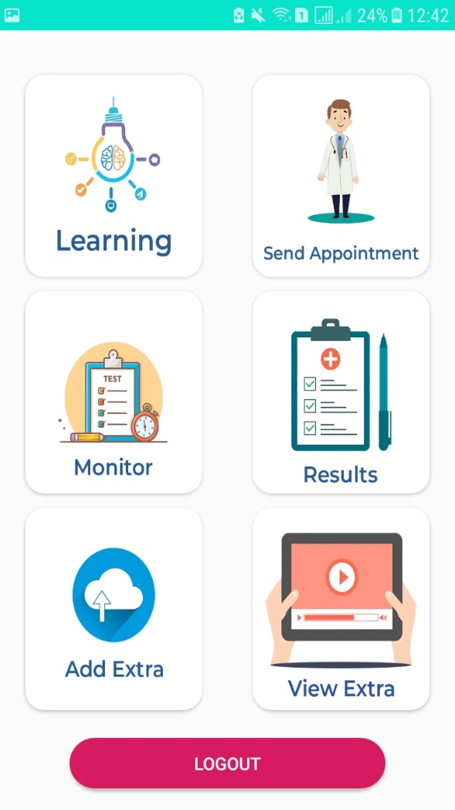
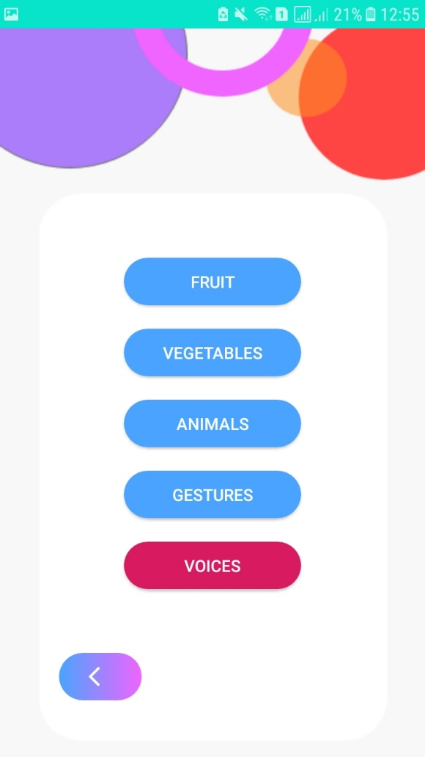
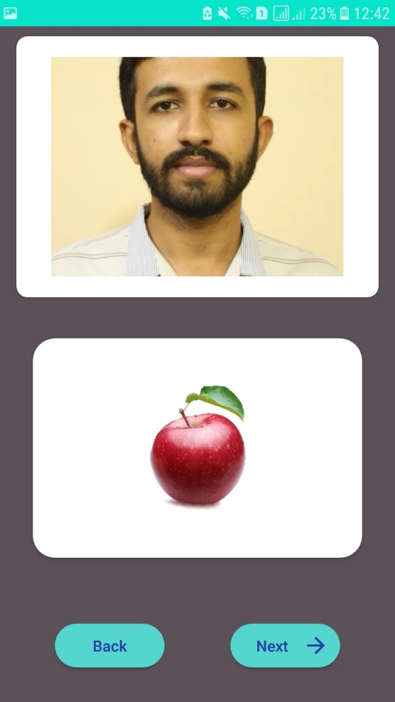
User Interface
_______________________________
_______________________________

Slide 19

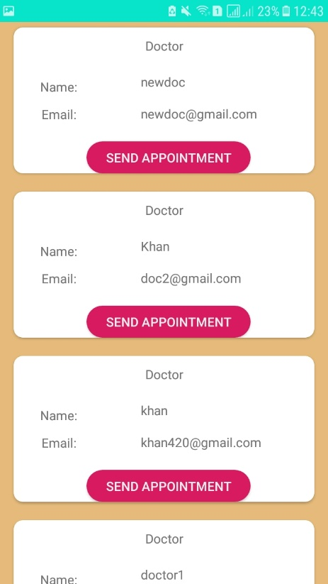
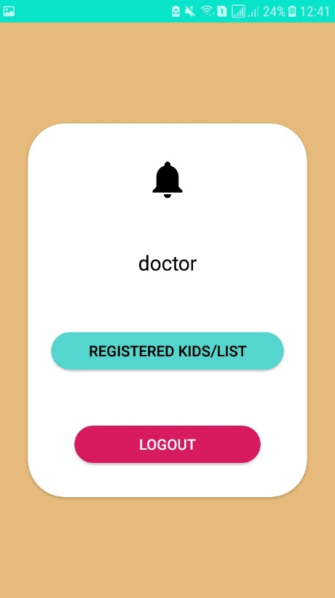
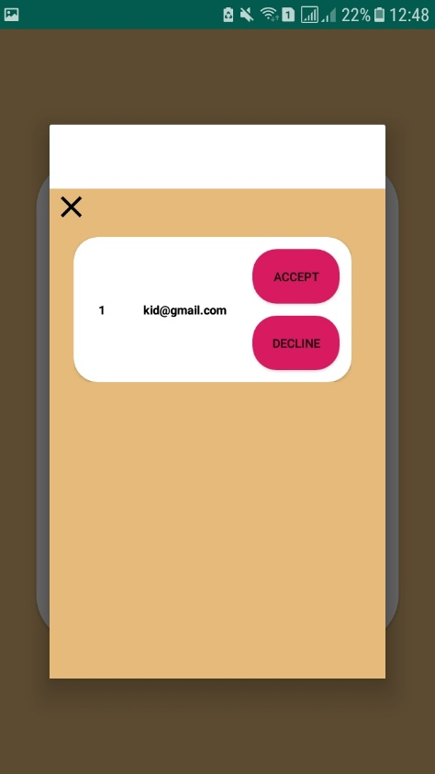
User Interface
_______________________________
_______________________________

Slide 20
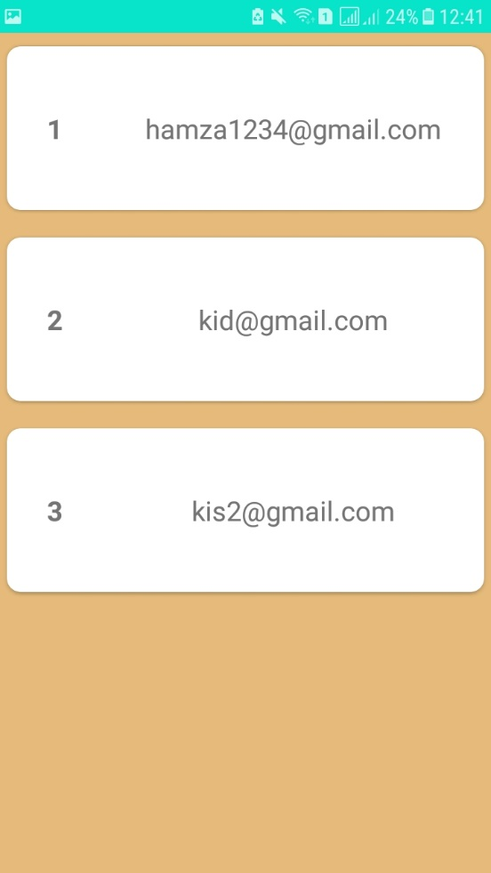
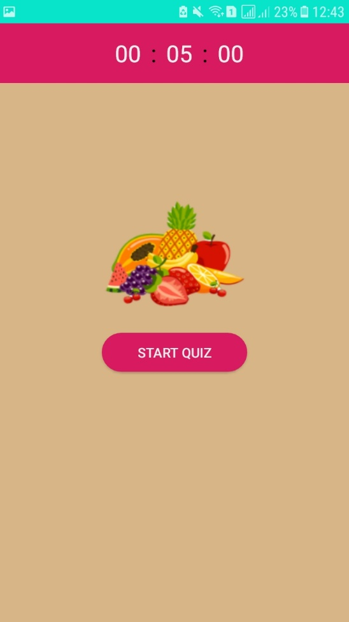
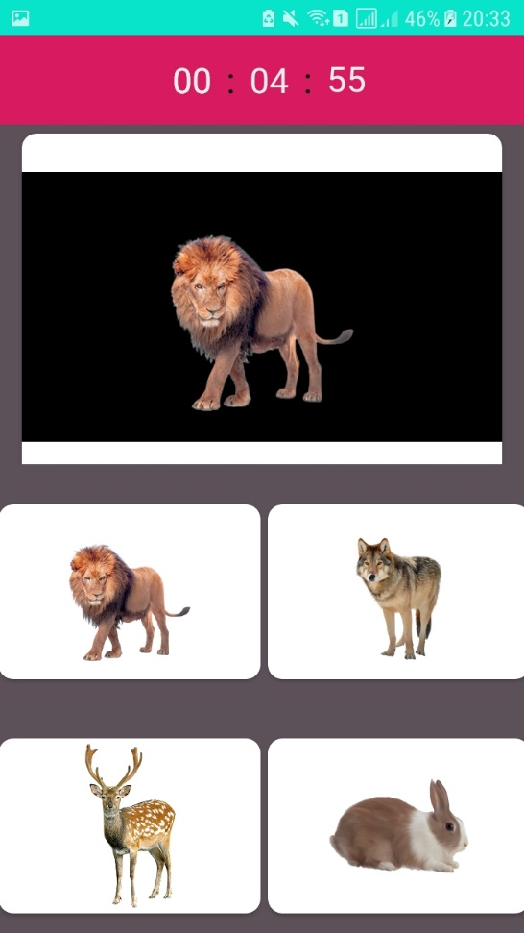
User Interface
_______________________________
_______________________________

Slide 21
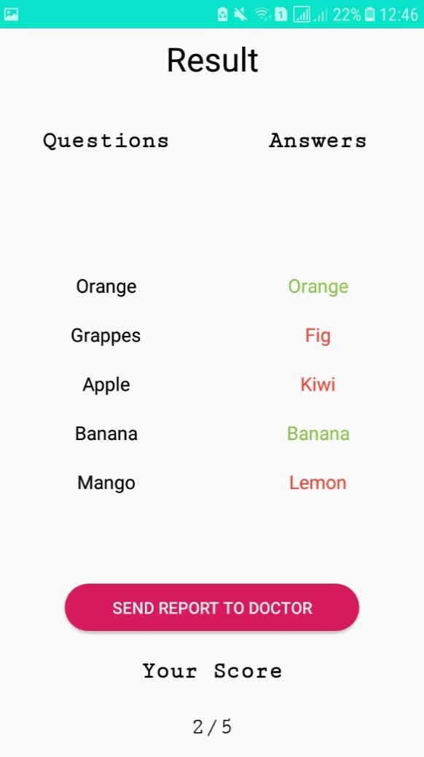
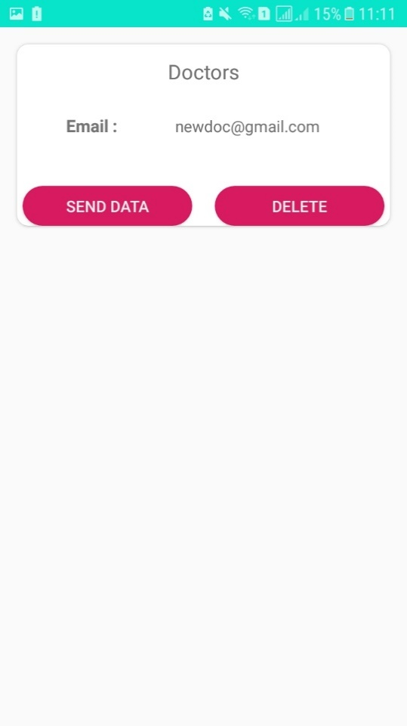
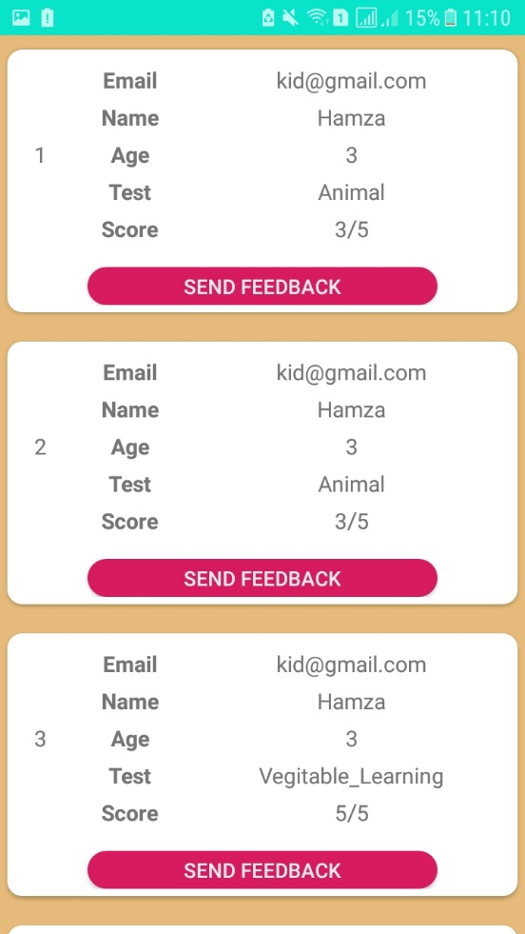
User Interface
_______________________________
_______________________________

Slide 22
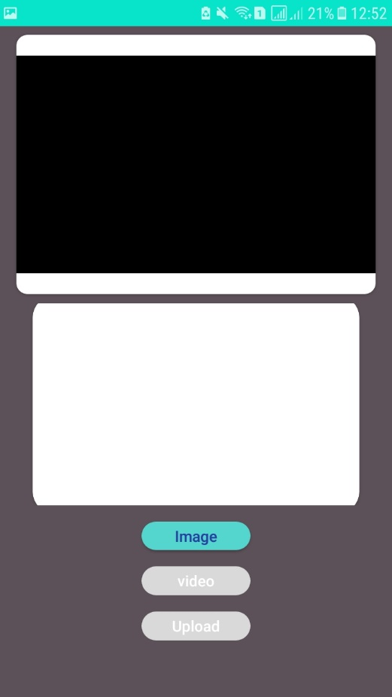
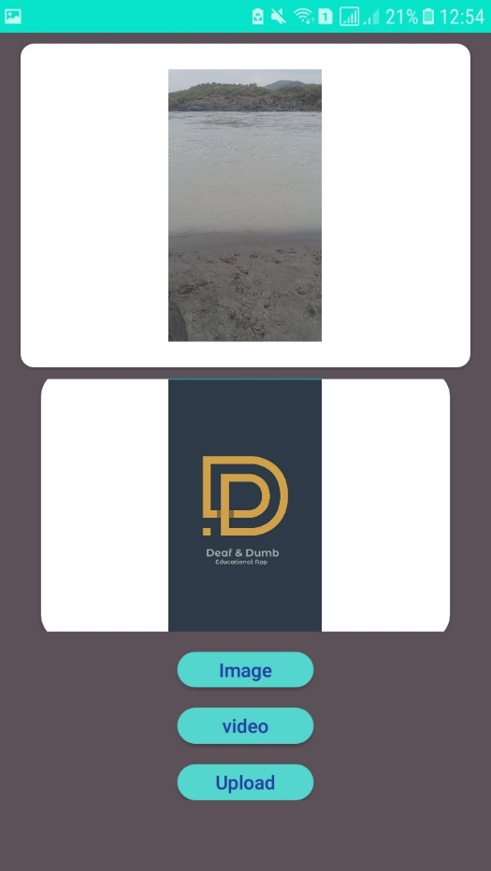
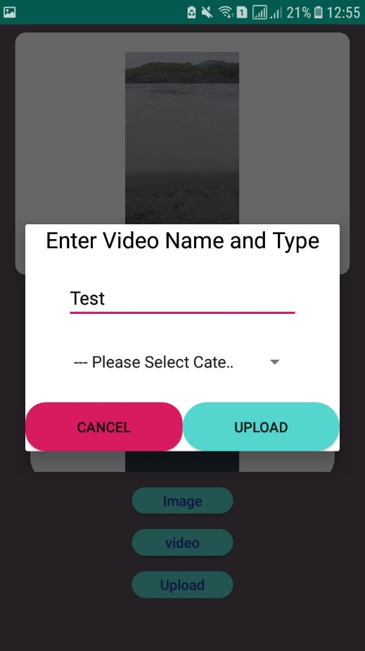
User Interface
_______________________________
_______________________________

Slide 23

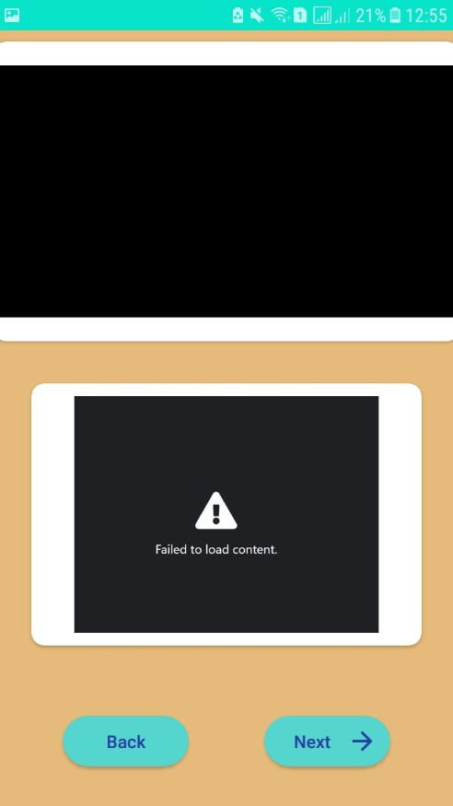
User Interface
_______________________________
_______________________________

Slide 24
Future Work
_______________________________
In future during learning Stages could be added to their learning section.
On successful learning children will be rewarded with game that could also be based on their speech skills.
_______________________________

Slide 25
References
_______________________________
[1] https://www.nidcd.nih.gov/health/what-is-voice-speech-language
[2]http://www.afasic.org.uk/about-talking/more-about-speech-language-and-communication/
[3]https://childdevelopment.com.au/areas-of-concern/using-language/receptive-language-understanding-words-and-language/
[4] disabilities/communication-disorders/understanding-language-disorders
[5]http://www.med.umich.edu/yourchild/topics/speech.htm
[6] Christopher G Brennan-Jones, Jo White, Robert W Rush, James Law, “Speech Therapy Programs for a Computer Aided Therapy System”,ELECTRONICS AND ELECTRICAL ENGINEERING, ISSN 1392 – 1215, 2010.No. 7(103).
[7] Gabriela Regila Gonzaga Rabelo and Luciana Pimentel Fernandes De Melo, “Counseling in rehabilitating process for hearing impaired children by parent perspective”, Revista CEFAC, Vol 18 No 2, 2016.
[8] Elahe Shojaei, Zahra Jafari, and Maryam Gholami, “Effect of Early Intervention on Language Development in Hearing-Impaired Children”, Iranian journal of otorhinolaryngology, 2016 Jan; 28(84): 13–21.
_______________________________

